Slide 1
TOPICS FOR DISCUSSION
Cost Terminology
Classification of Costs – direct, indirect, fixed, variable, Preoperative & Preliminary, overhead and sunk cost etc.
Relevance of different cost terms in effective cost estimating, budgeting and decision making
Greenfield & Brownfield Projects

Slide 2
Mission
Consistent with the vision and values of the founder Jamsetji Tata, Tata Steel strives to strengthen India’s industrial base through effective utilisation of staff and materials.
The means envisaged to achieve this are
Cutting-edge technology
High productivity,
Modern management

Slide 3
Various Types of Costs
1. Direct cost
2. Indirect cost
3. Fixed Cost
4. Variable cost
5. Opportunity cost
6. Sunk cost
7. Relevant Cost

Slide 4
Direct costs
Direct costs are expenses tied directly to the product or the project.
Direct costs include labor, raw materials, consumables, staff salaries, fuel, etc. All the direct efforts towards a project

Slide 5
Indirect costs
Indirect costs are essential for business operations but not directly linked to the project.
These costs are relatively stable over time and easier to control
Indirect costs include utilities, consulting, legal and financial fees, administrative expenses, maintenance expenses, phone, internet, rent, insurance, etc.

Slide 6
Major Cost Terms – Associated with Projects
1. CAPEX – Capital Expenditure
2. OPEX – Operating Expenditure
3. CLOSURE COST

Slide 7
Relevance of Direct & Indirect costs
Businesses have fixed budget, and when cost exceeds, they affect other operations.
Therefore, you must track these direct and indirect costs to remain within budget.

Slide 8
Fixed, Variable & Sunk Costs
Fixed costs are one-off charge. These fees are not linked to how long your project goes on for.
Example - If you need to pay for one-time advertising to secure a specialist engineer, or you are paying for a day of Agile consultancy to help you start the project up the best way, those are fixed costs
Variable costs change with the length of your project. It's more expensive to pay staff salaries over a 12 month project than a 6 month one. Machine hire over 8 weeks is more than for 3 weeks.
Sunk costs means that have already been incurred. This is a loss which should not play any part in determining the future of the project.

Slide 9
MARGINAL COSTING
is “the ascertainment of marginal costs and of the effect on profit of changes in volume or type of output by differentiating between fixed costs and variable costs.”
Variable costs vary with volume of production or output, whereas fixed costs remains unchanged irrespective of changes in the volume of output.

Slide 10
Features of Marginal Costing:
Appropriate and accurate division of total cost into fixed and variable by picking out variable portion of semivariable costs also.
Valuation of stocks such as finished goods, work-in-progress is valued at variable cost only.
It combines the techniques of cost recording and cost reporting

Slide 11
Managerial decisions can be taken with the help of marginal costing
Make or buy decisions,
Exploring foreign markets,
Accept an order or not,
Determination of selling price in different conditions,
Replace one product with some other product,
Optimum utilisation of labour or machine hours,
Evaluation of alternative choices,
Subcontract some of the production processes or not,
Expand the business or not,
Diversification,
Shutdown or continue.

Slide 12
Limitations of Marginal Costing
separation of costs into fixed and variable present’s technical difficulties and no variable cost is completely variable nor is a fixed cost completely fixed
stock of finished goods and work-in-progress are understated. therefore, not correct to eliminate fixed costs from finished stock and work-in-progress
Though for short-term assessment of profitability marginal costs may be useful, long term profit is correctly determined on full costs basis only
With increased automation and technological developments, the impact on fixed costs on products is much more than that of variable costs

Slide 13
MARGINAL COSTING TERMINOLOGY
1. Contribution:
C = S – V → (1)
C = contribution, S= Sales & V = Variable cost
OR
C is also = F + P
F = Fixed Cost & P = Profit
2. Profit Volume Ratio (P/V Ratio) or contribution Ratio = (Contribution / Sales) * 100

Slide 14
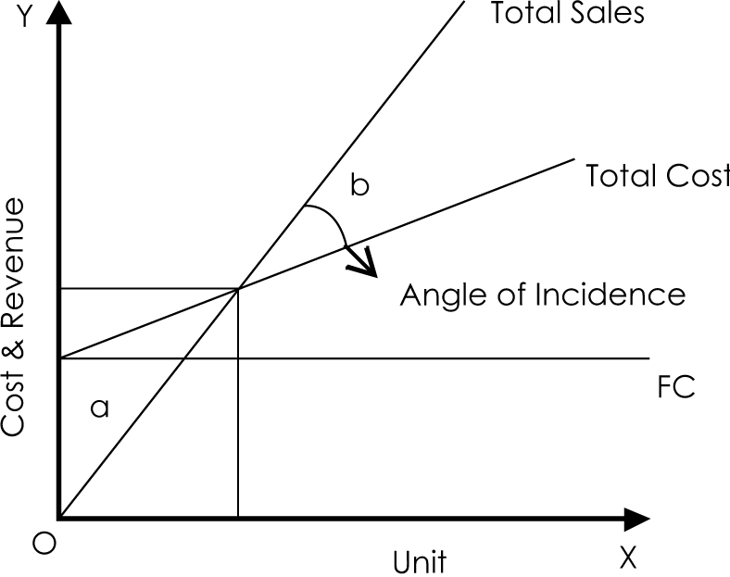


Break Even Analysis i.e CVP analysis

